Slide 1

6th Grade Math
Unit 2, Lesson 7 Multiplying Positive Fractions Volume 1, pg. 78

Slide 2


Benchmark
MA.6.NSO.2.2
Extend previous understanding of multiplication and division to compute products and quotients of positive fractions by positive fractions with procedural fluency.
volume 1, pg. 78

Slide 3
Integrated Mathematical Thinking and Reasoning Standards
MA.K12.MTR.5.1 Use patterns and structure to help understand and connect mathematical concepts.
volume 1, pg. 78

Slide 4

Learning Target
I can fluently multiply positive fractions by positive fractions.
volume 1, pg. 78

Slide 5

Warm-Up
volume 1, pg. 78

Slide 6

2.7.1 Warm-Up: Food Science
Dr. Charlotte Armah is a research scientist at the Institute of Food Research. She leads experiments involving human volunteers to learn whether or not eating particular foods can protect us from diseases such as cardiovascular disease and cancer. Her work allows her to combine her scientific and math expertise, interest in helping others, and enjoyment of interacting with different people.
What is one aspect of Charlotte’s story that was surprising to you? Explain why this stood out to you.
volume 1, pg. 78

Slide 7

Refresher
volume 1, pg. 79

Slide 8


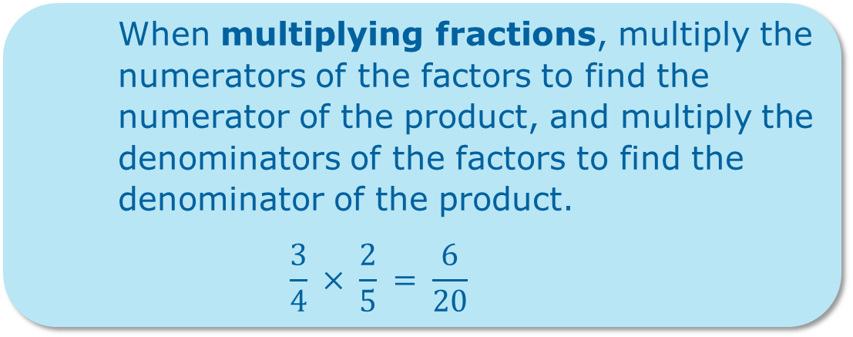
2.7.2 Refresher: Multiplying Fractions
When multiplying fractions, multiply the numerators of the factors to find the numerator of the product, and multiply the denominators of the factors to find the denominator of the product.
$$\frac{3}{4} × \frac{2}{5} = \frac{6}{20}$$
volume 1, pg. 79

Slide 9
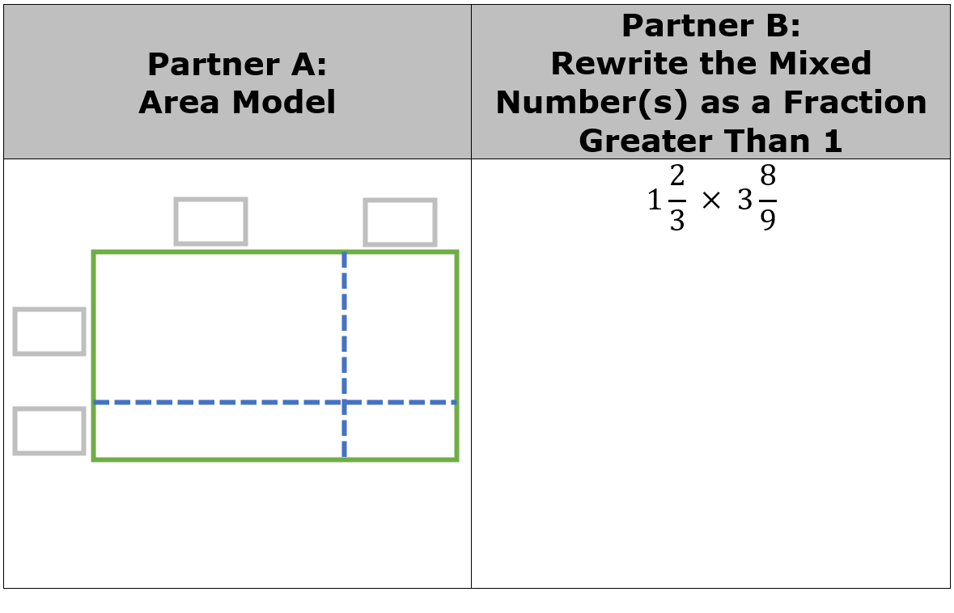
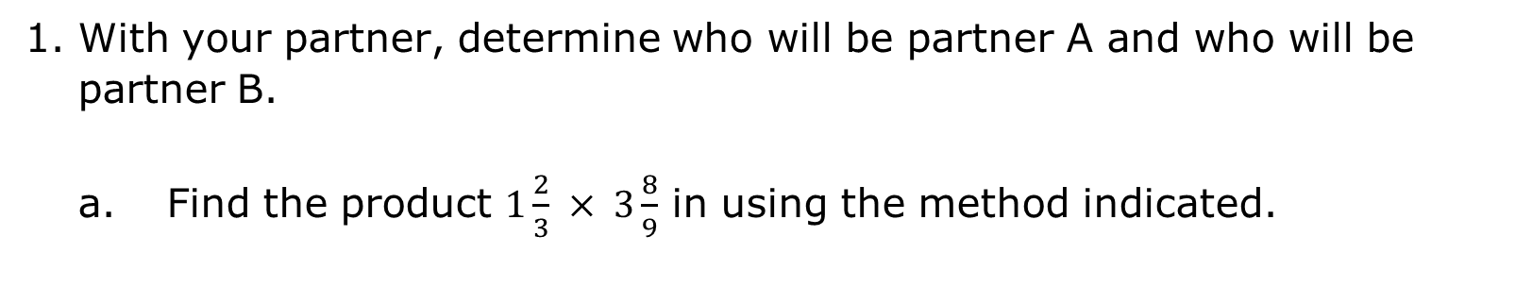
With your partner, determine who will be partner A and who will be partner B.
Find the product $1\frac{2}{3} × 3\frac{8}{9}$ in using the method indicated.
volume 1, pg. 79

Slide 10
Compare your work with your partner to verify that you both found the same product. Discuss any errors and make corrections as needed. Once you are in agreement, write your partner’s work in your workbook in the space provided.
volume 1, pg. 79

Slide 11

Guided Instruction
volume 1, pg. 79

Slide 12
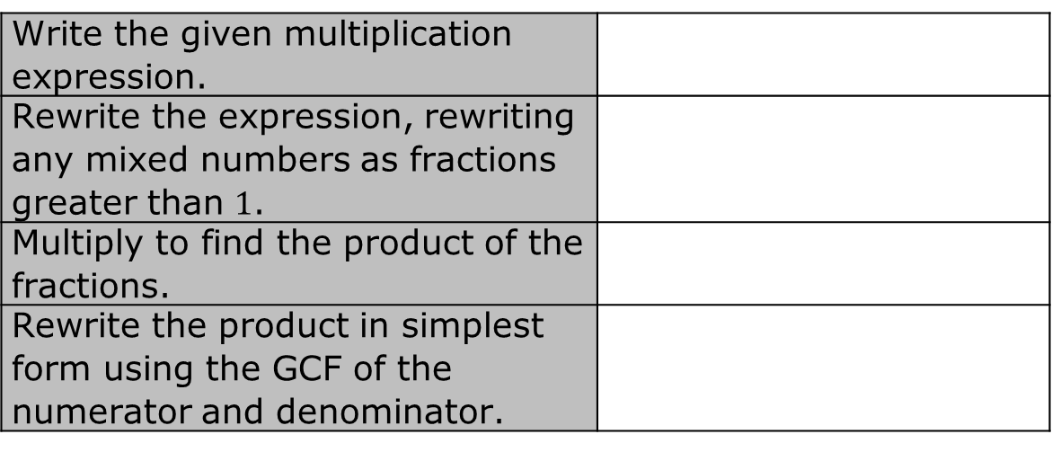
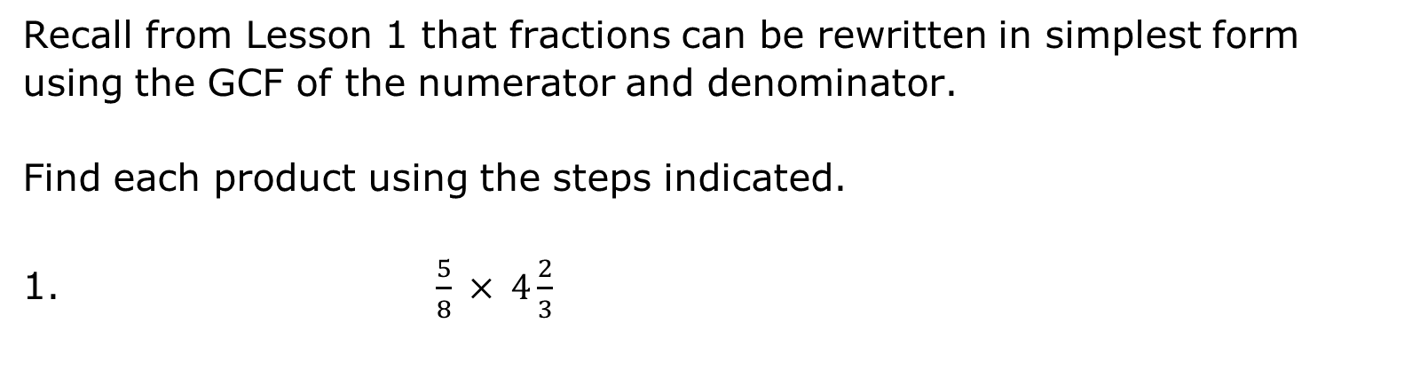
2.7.3 Guided Instruction: Multiplying Fractions
Recall from Lesson 1 that fractions can be rewritten in simplest form using the GCF of the numerator and denominator.
Find each product using the steps indicated.
1. $\frac{5}{8} × 4\frac{2}{3}$
Write the given multiplication expression.
Rewrite the expression, rewriting any mixed numbers as fractions greater than $1$.
Multiply to find the product of the fractions.
Rewrite the product in simplest form using the GCF of the numerator and denominator.
volume 1, pg. 79

Slide 13
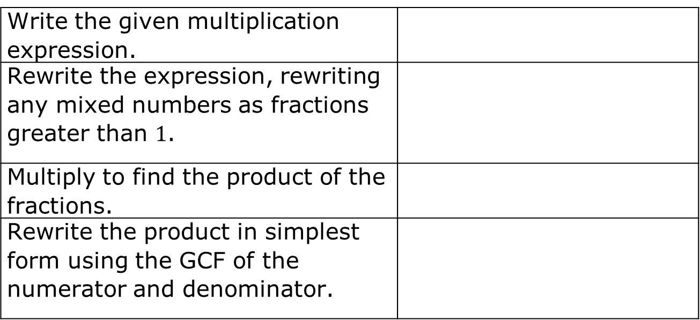
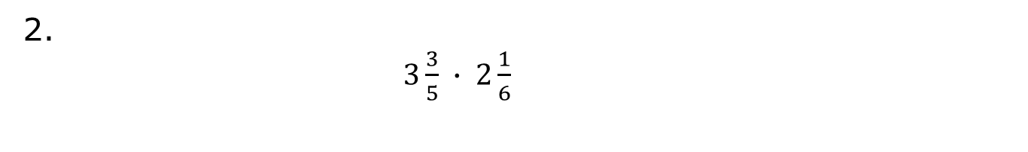
2.
$3\frac{3}{5} ∙ 2\frac{1}{6}$
Write the given multiplication expression.
Rewrite the expression, rewriting any mixed numbers as fractions greater than $1$.
Multiply to find the product of the fractions.
Rewrite the product in simplest form using the GCF of the numerator and denominator.
volume 1, pg. 79

Slide 14

Try It
volume 1, pg. 80

Slide 15

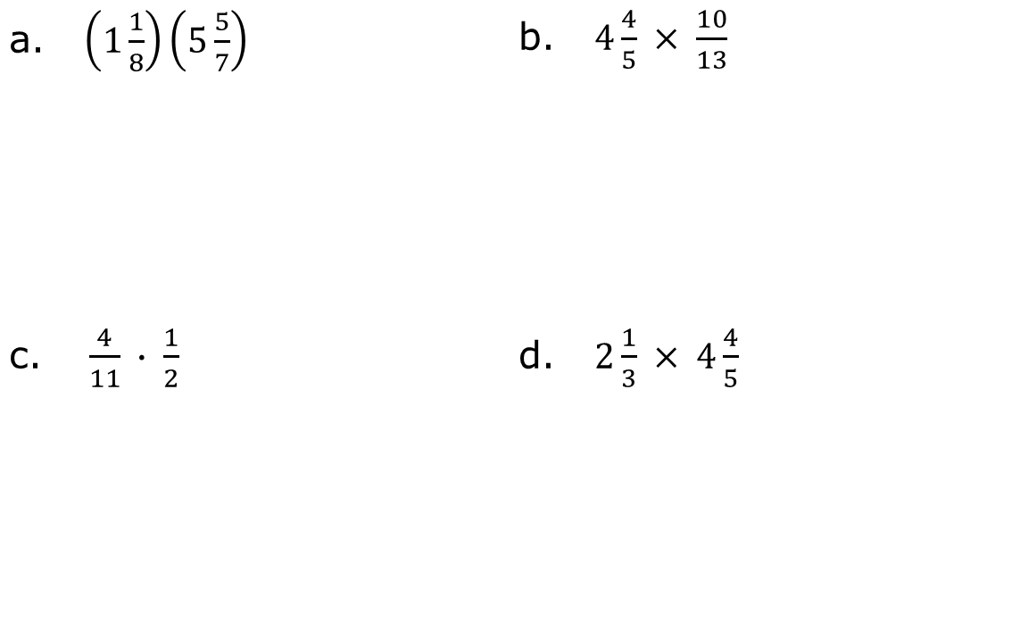
2.7.4 Try It: Multiplying Fractions
Find each product. Rewrite each product in simplest form. Show your work.
a. $\left(1\frac{1}{8}\right)\left(5\frac{5}{7}\right)$ | b. $4\frac{4}{5} × \frac{10}{13}$
c. $\frac{4}{11} ∙ \frac{1}{2}$ | d. $2\frac{1}{3} × 4\frac{4}{5}$
volume 1, pg. 80

Slide 16
Complete the statement to describe which product was the most challenging for you to find.
The product of _________ was most challenging for me
to find because ________________________________
____________________________________________.
What is a strategy that could help you on a similar problem in the future?
volume 1, pg. 80

Slide 17

Your Turn
volume 1, pg. 80

Slide 18
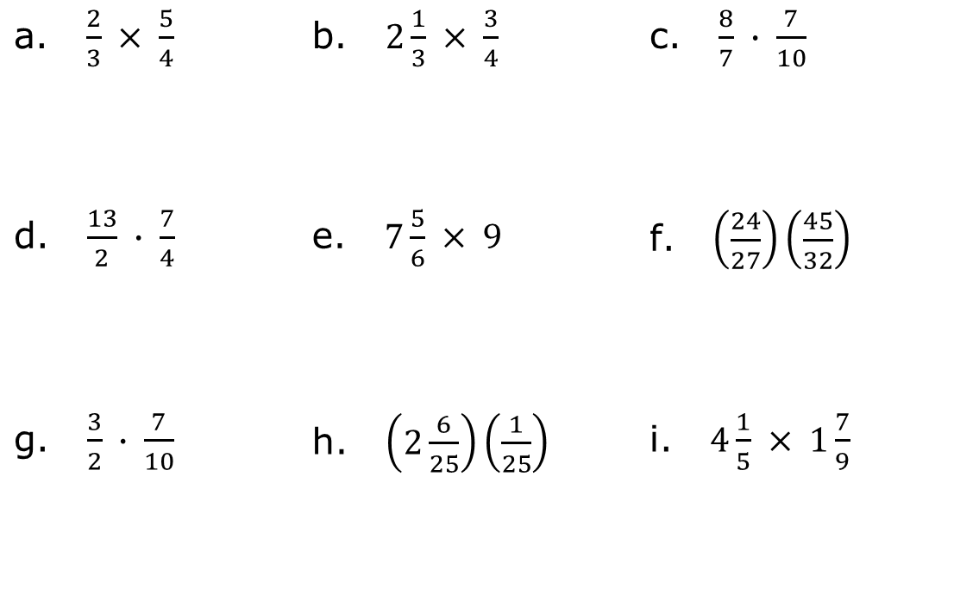
2.7.5 Your Turn!
Find each product. Simplify when possible.
a. $\frac{2}{3} × \frac{5}{4}$ | b. $2\frac{1}{3} × \frac{3}{4}$ | c. $\frac{8}{7} ∙ \frac{7}{10}$
d. $\frac{13}{2} ∙ \frac{7}{4}$ | e. $7\frac{5}{6} × 9$ | f. $\left(\frac{24}{27}\right)\left(\frac{45}{32}\right)$
g. $\frac{3}{2} ∙ \frac{7}{10}$ | h. $\left(2\frac{6}{25}\right)\left(\frac{1}{25}\right)$ | i. $4\frac{1}{5} × 1\frac{7}{9}$
volume 1, pg. 80

Slide 19

Wrap-Up
volume 1, pg. 81

Slide 20
2.7.6 Wrap-Up: Reflection
In this unit, you have learned multiple concepts including those listed below.
Finding the GCF and LCM of two or more numbers
Rewriting sums using distributive property
Multiplying and dividing decimals
Multiplying fractions
volume 1, pg. 81

Slide 21

Use the stoplight reflection below to share how you are feeling about each of these concepts at this point.
I still feel stuck about how to…
I’m starting to get the hang of…
I feel confident and ready to go with…
volume 1, pg. 81

